Slide 1
ArtMove Final Presentation
Ekin Uyumaz
Bora Bardük
Muhammed Çavuşoğlu
Duygu Durmuş
Mert İnan

Slide 2
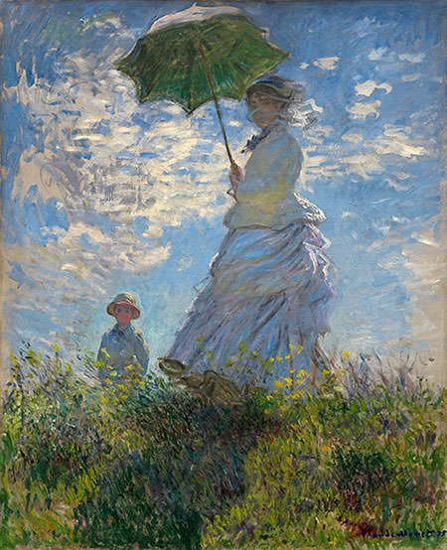
Outline
Overview
Changes
Work Done
Results
Challenges & Solutions

Slide 3
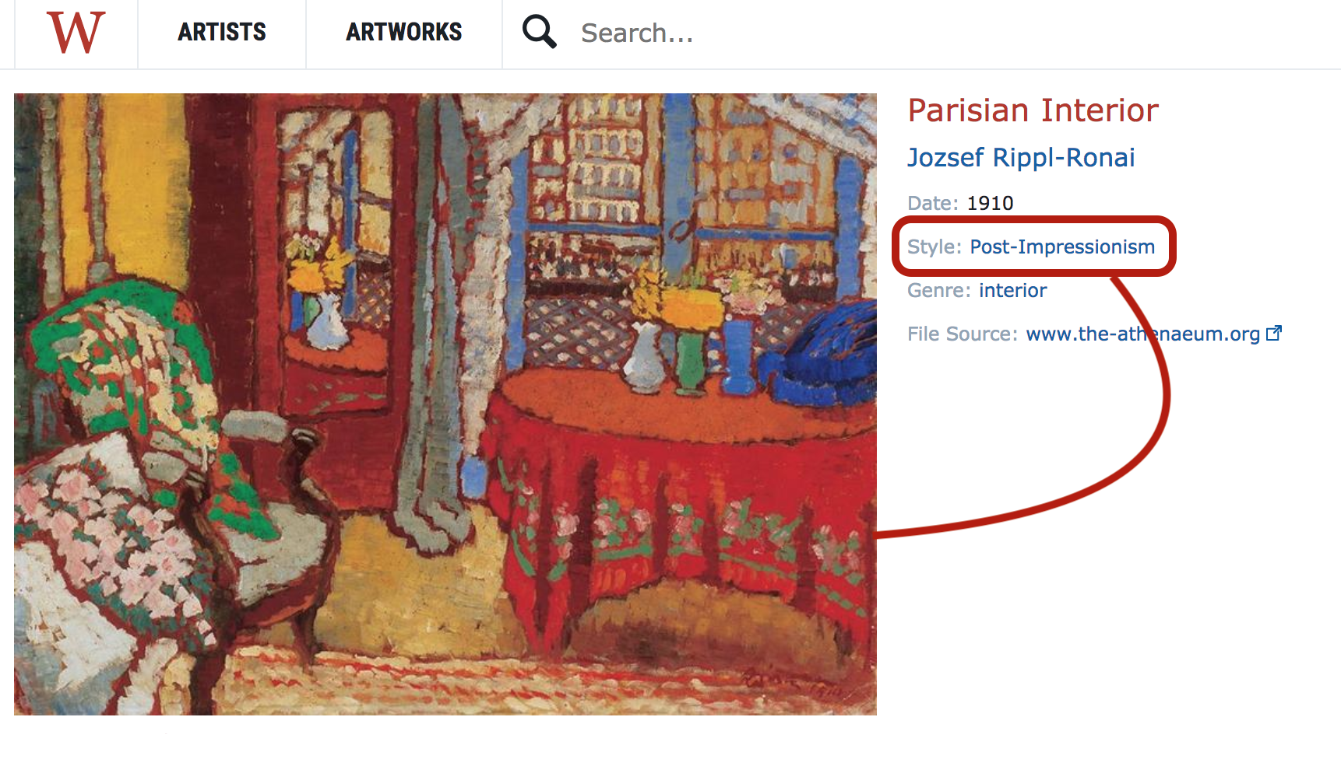
Overview of Project
The project aims to predict art movements of artworks
For artworks, WikiArt data from Kaggle was used
Comparison of different machine learning algorithms on the same classification problem
kNN ( k-Nearest Neighbour)
CNN (Convolutional Neural Network)
Feature Extraction
With HOG(Histogram of Oriented Gradients)

Slide 4
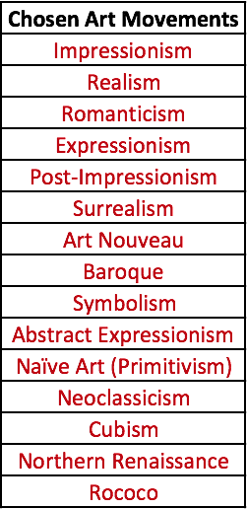
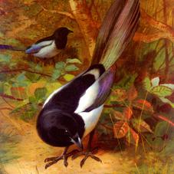
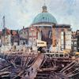
Dataset Description
From 149 art movements that were in the WikiArt database, 15 were chosen.
For kNN and SVM: 100x100 pixel images
For CNN: 227x227 pixel images

Slide 5
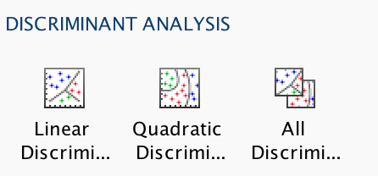
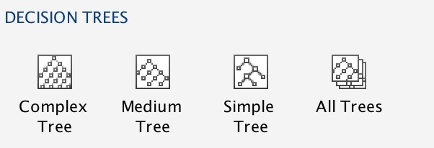
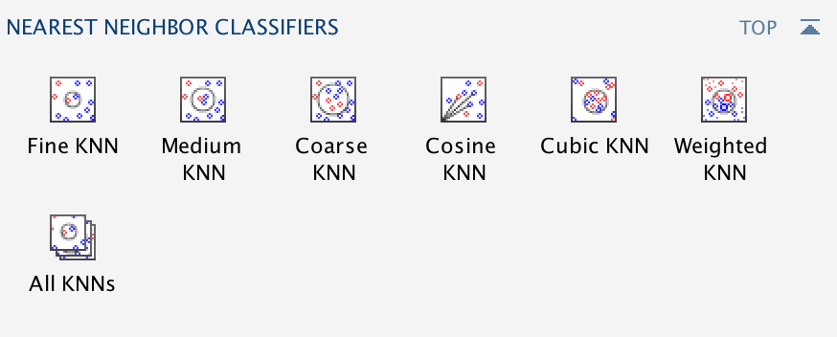
2. Changes After Previous Presentation
LSTM is no longer considered
CNN is used only for feature extraction, not designed from scratch (AlexNet)
Instead of LSTM, following new models are introduced:
Decision Trees
Linear & Quadratic Discriminants
Multiclass SVM
Different types of kNN
Some Ensemble Models

Slide 6
3. Work Done
Separating Images
HOG Feature Extraction of All Images
AlexNet Feature Extraction
Feature Selection
Using Classification Learner App

Slide 7
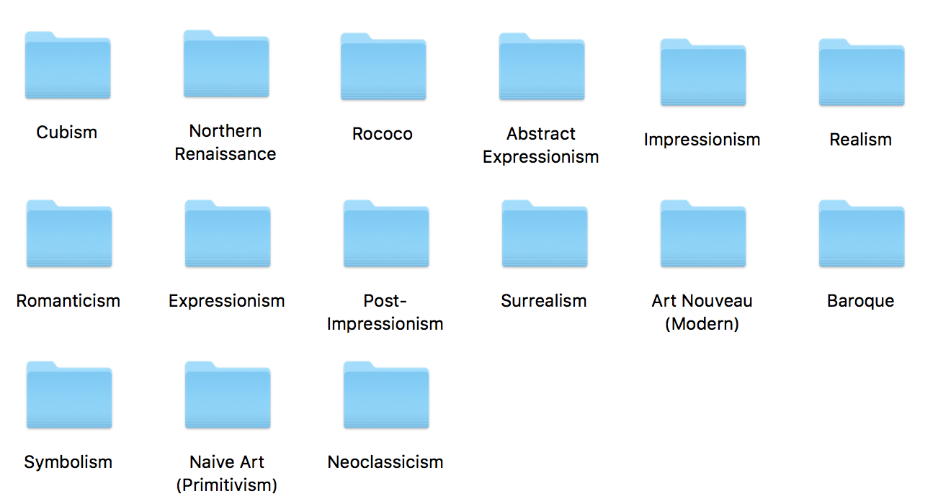
Separating Images Into Styles
All train data and test data got separated into 15 art styles.
Train dataset is 15000 images, and 1000 in each style.
Test dataset is 6000 images of 400 in each style.
For AlexNet, only a portion of data is used.

Slide 8
HOG Feature Extraction of All Images
Histogram of Oriented Gradients (HOG) Features were extracted from all the training and testing data to be used in classification algorithms such as kNN or decision trees.
Depends on size, however, resizing or cropping generally does not affect the quality of classification as long as all image sizes are consistent.

Slide 9
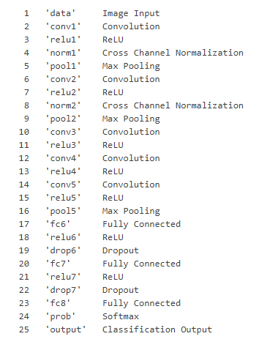

AlexNet Feature Extraction
Used pre trained convolutional neural network AlexNet for feature extraction.
To obtain the features, used activations on the fully connected layer 'fc7'.
Used 20 layers
4096-D vectors contain the activations of the hidden layer.
fc7

Slide 10
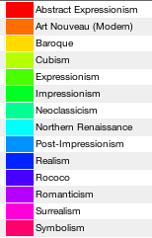
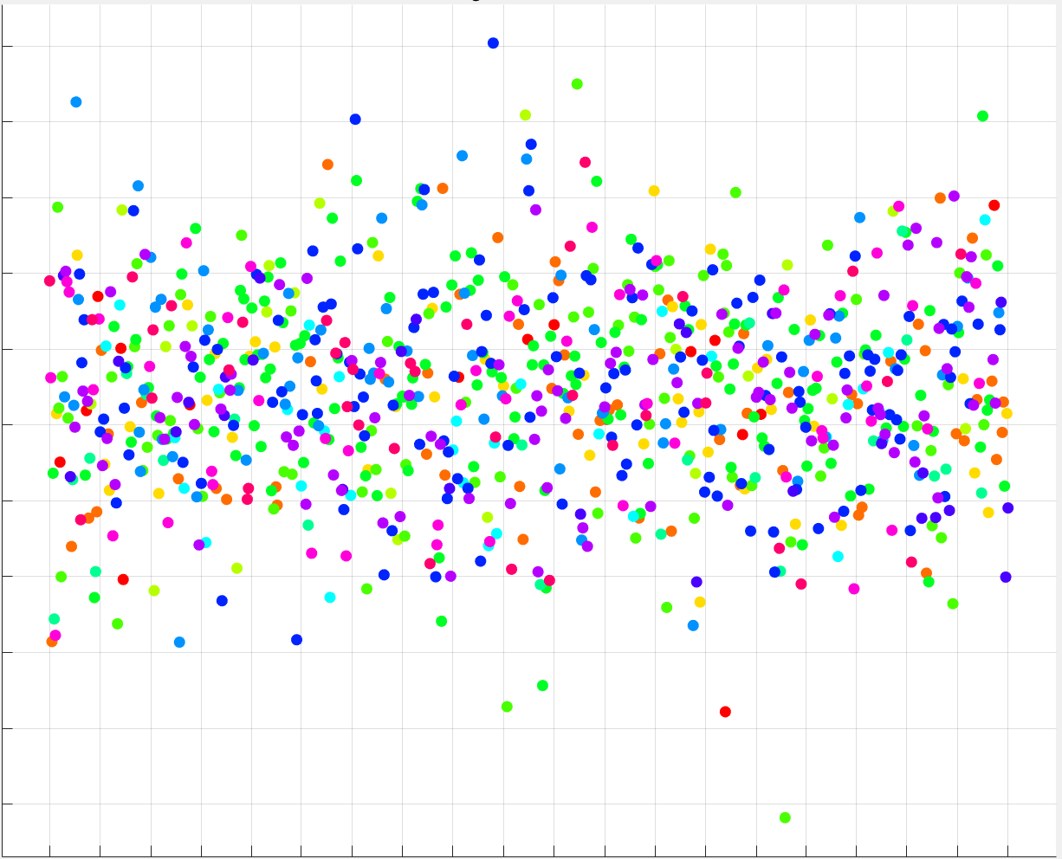
AlexNet Feature Extraction
The extracted features of the CNN were used to train various models and compare the results
Extracted 4096 features.
Features extracted by the AlexNet

Slide 11
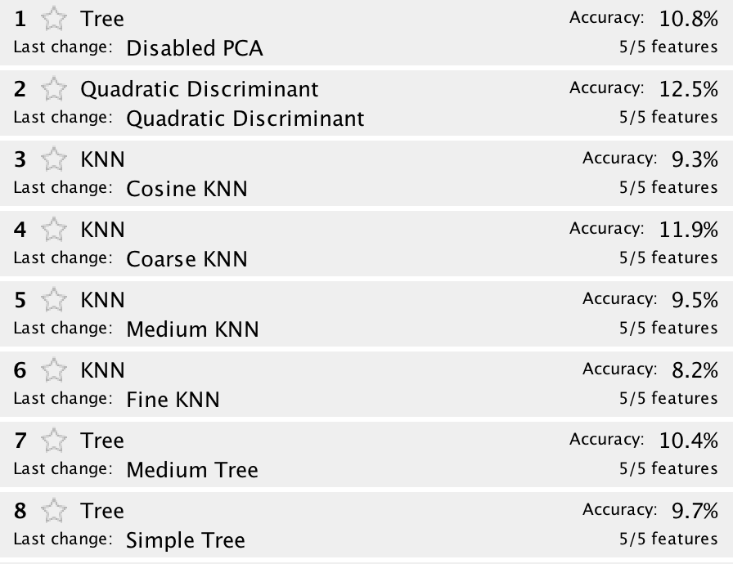
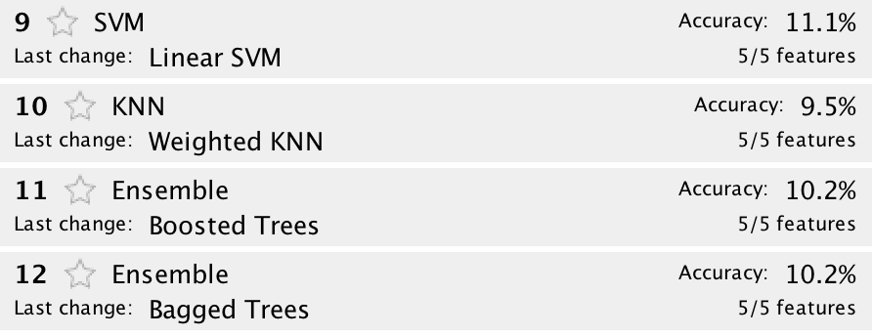
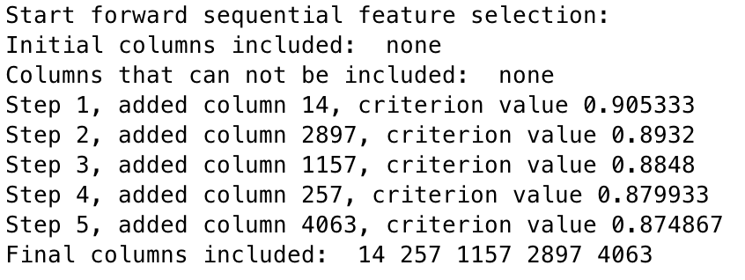
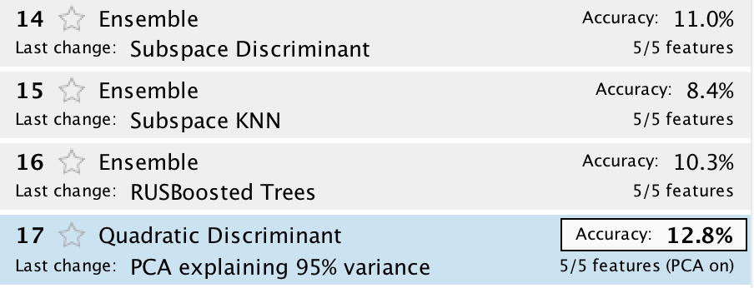
Feature Selection
Aim :
Shorter training times
Avoiding curse of dimensionality
Better Accuracy
By using forward selection, 5 best features are selected.

Slide 12
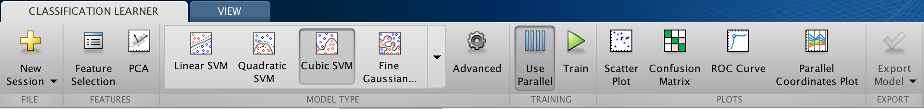
Using Classification Learner App
MATLAB provides an App in its Machine Learning Toolbox.
This was used to train multiple models at once and choose the best model with validation
Holdout Validations of 25% and 10% were used.
No validation was used to get training accuracy.
Principal component analysis (PCA) was used in a range of 70-95% explained variance.
PCA transforms features and removes redundant dimensions.

Slide 13
4. Results

Slide 14
 |  |  | Accuracy
HOG Features (~4000) | 25% Holdout Validation | Tree | ~13%
 |  | Discriminant | ~16.8%
 |  | SVM | ~14%
 |  | kNN | ~16.2%
 |  | Ensemble | ~10%
 | 10% Holdout Validation | Subspace Discriminant Ensemble | ~14.1%
 | No Validation | Quadratic Discriminant | ~25.1%
AlexNet Features (~4000) | 25% Holdout Validation | SVM | ~35.1%
 |  | kNN | ~26.4%

Slide 15
Focus: HOG Feature Extraction Results

Slide 16
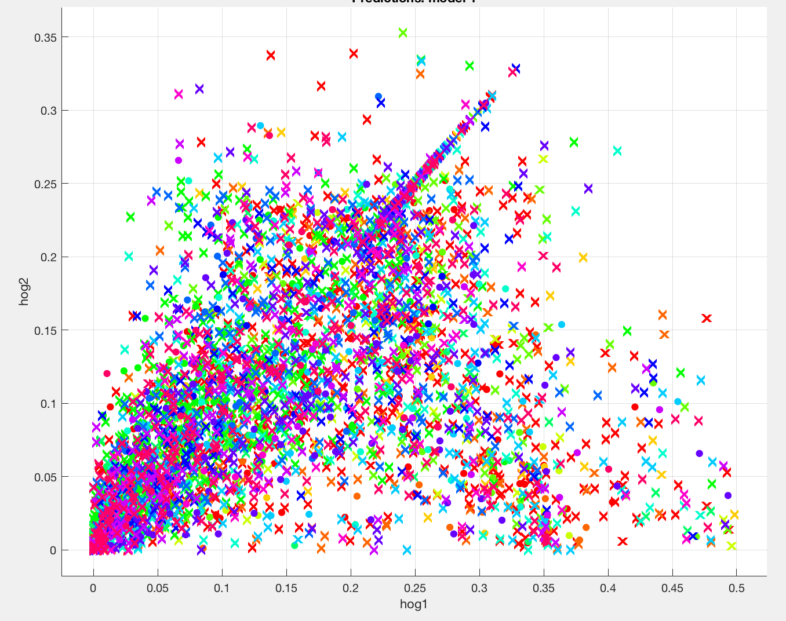
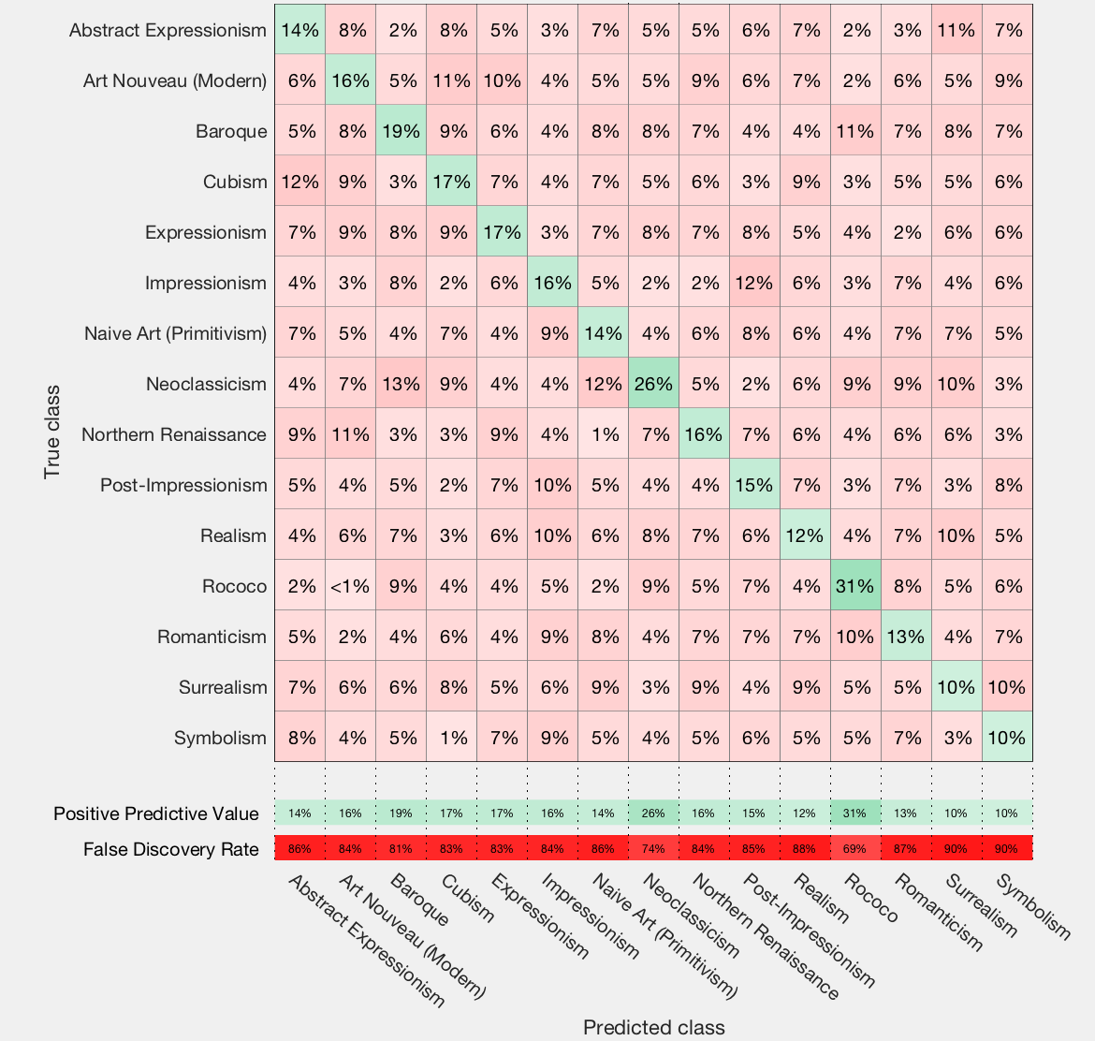
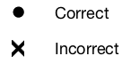
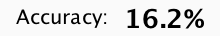
Cosine kNN
A nearest-neighbor classifier that uses the cosine distance metric
Prediction Results:
with 4356 features

Slide 17
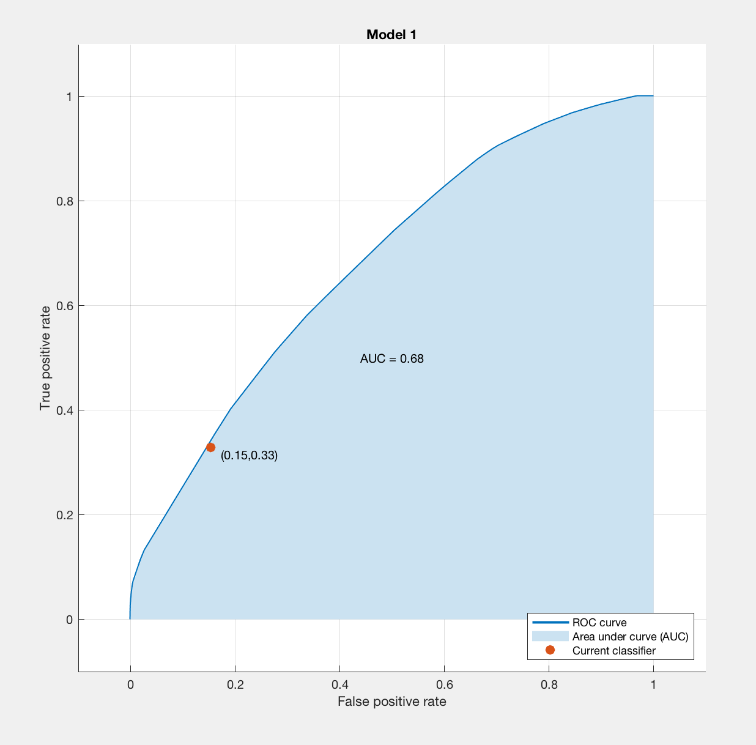
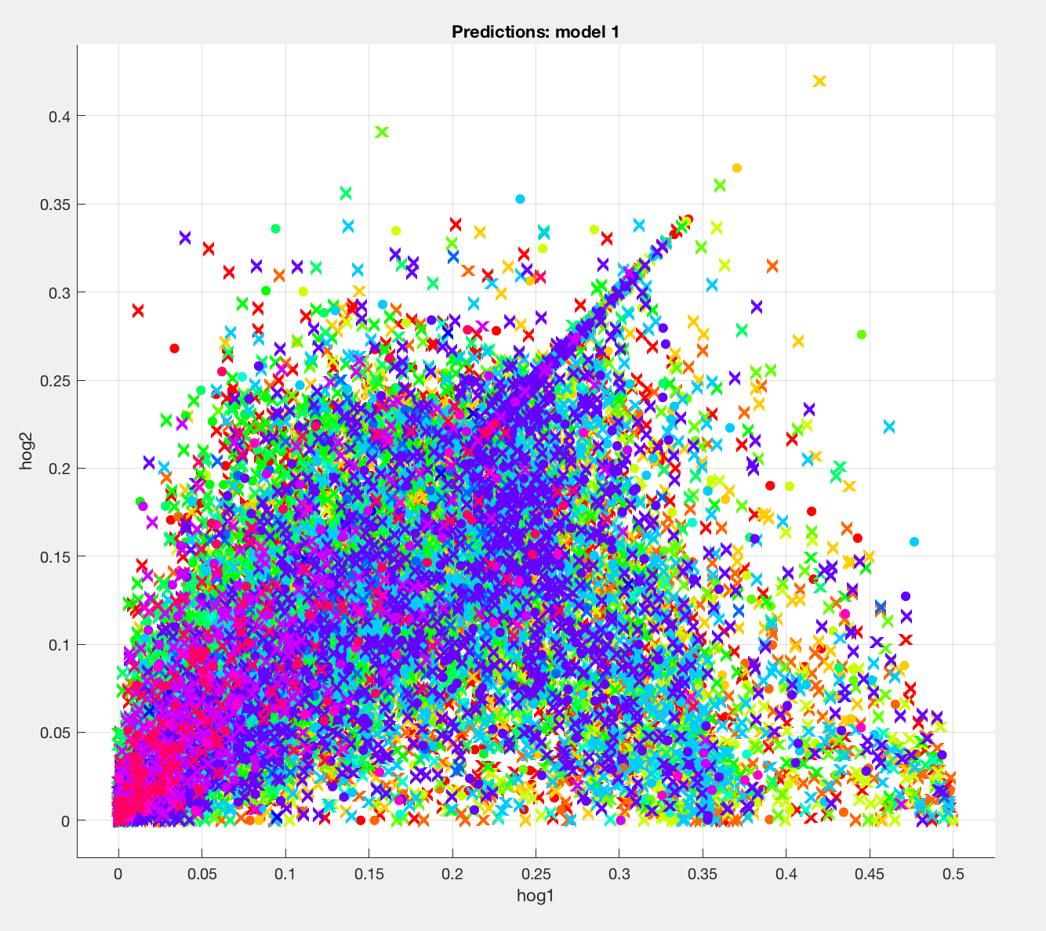
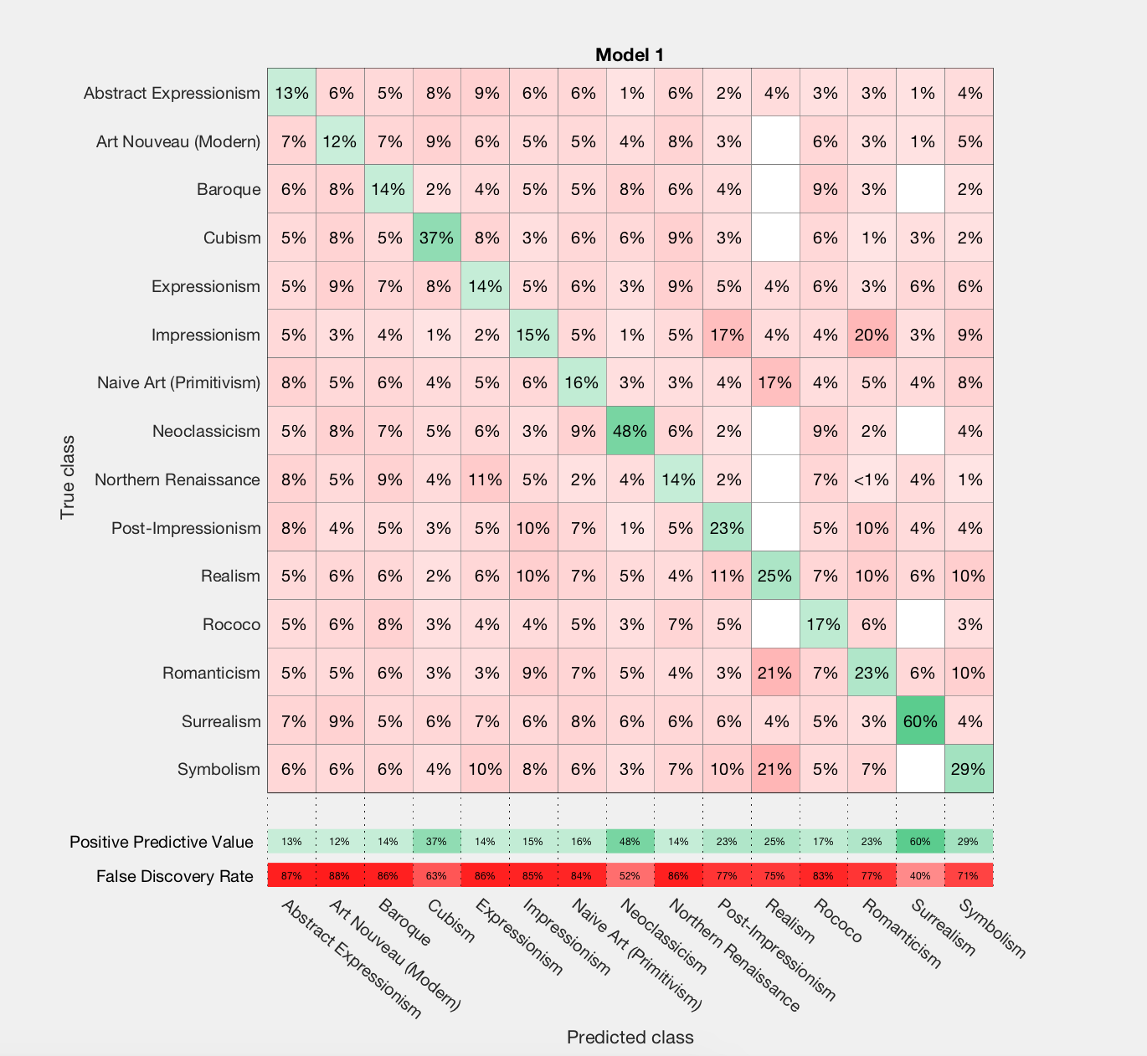

Complex Tree
A decision tree with many leaves that makes many fine distinctions between classes ( number of splits = 100)
Prediction Results:
with 690 features (PCA)

Slide 18
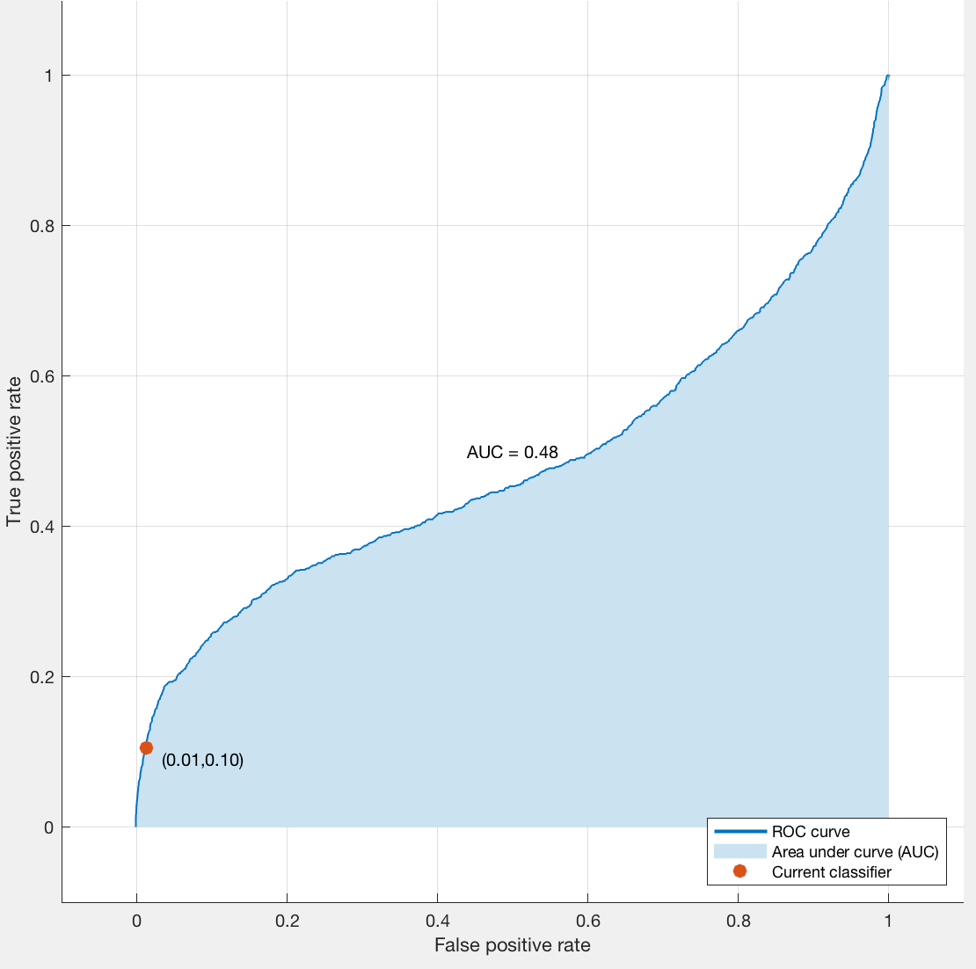
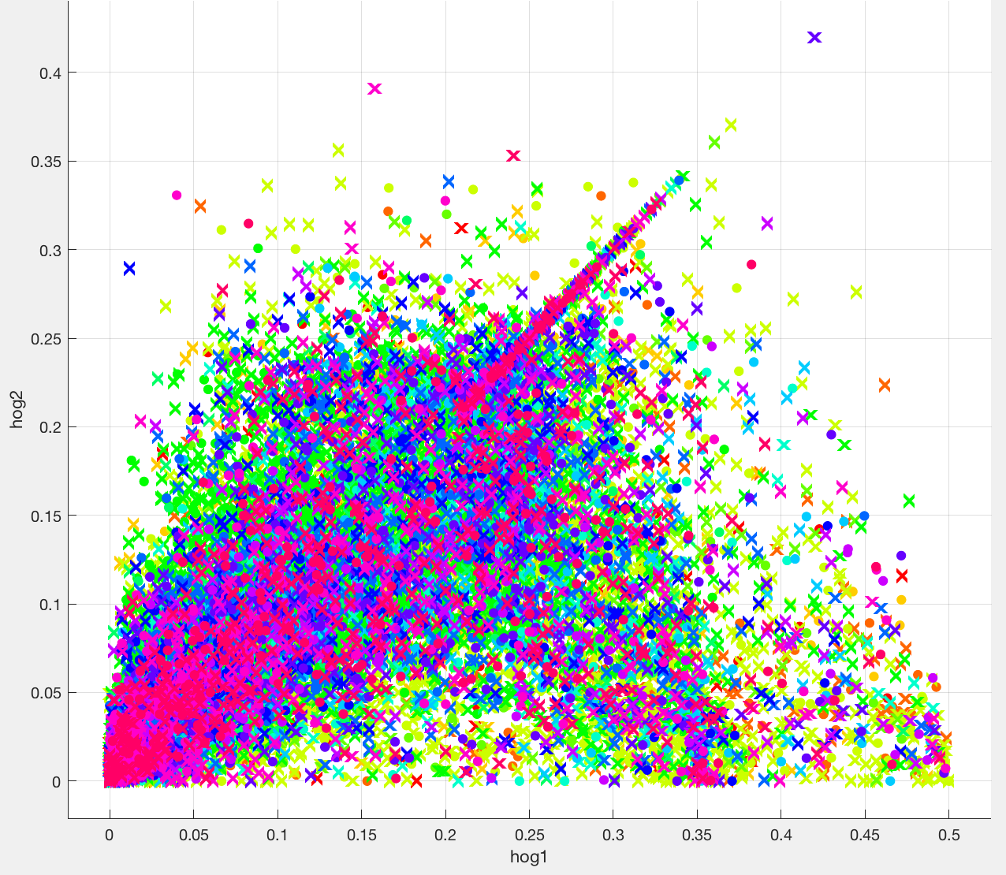
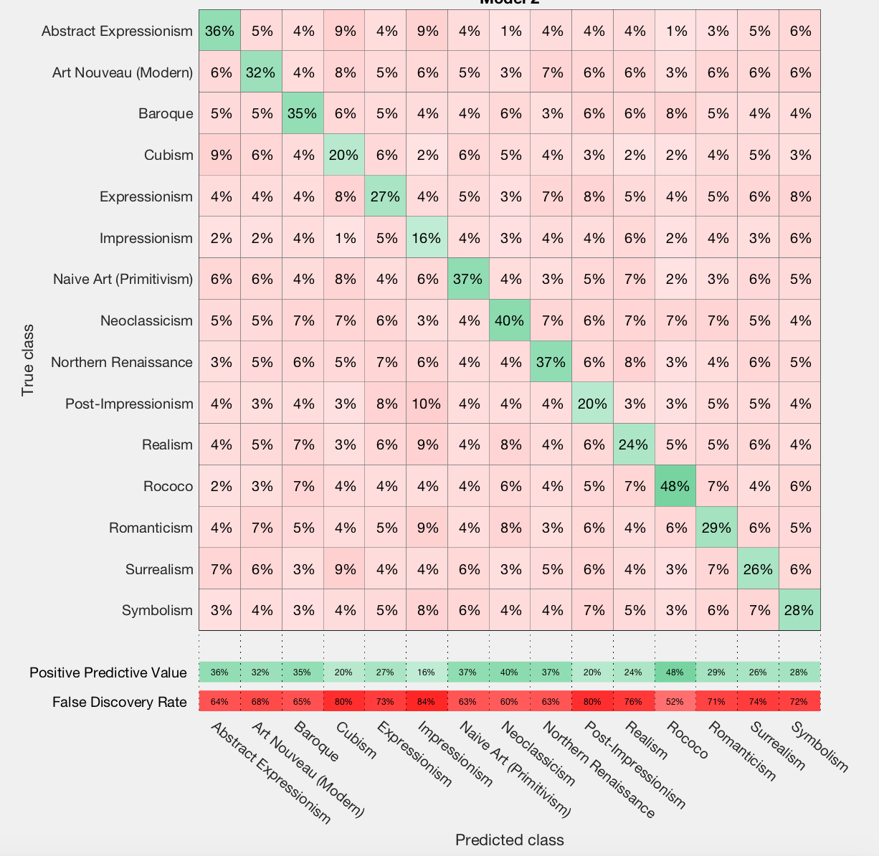
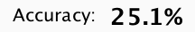
Quadratic Discriminant
Prediction Results:
Fast, easy to interpret classifier that creates elliptical, parabolic or hyperbolic boundaries between classes.
with 690 features(PCA)
Prediction on 1000 samples gave 64.9% accuracy

Slide 19
Focus: AlexNet Feature Extraction Results

Slide 20
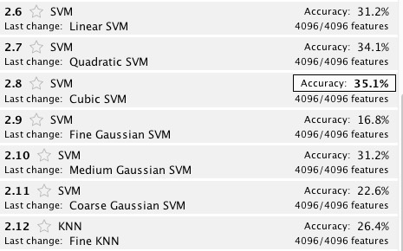
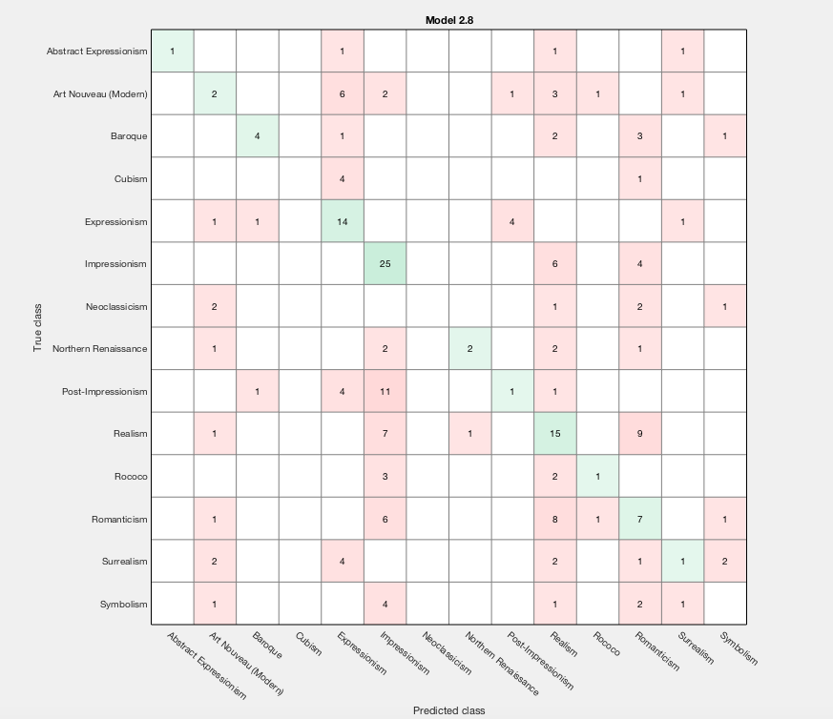
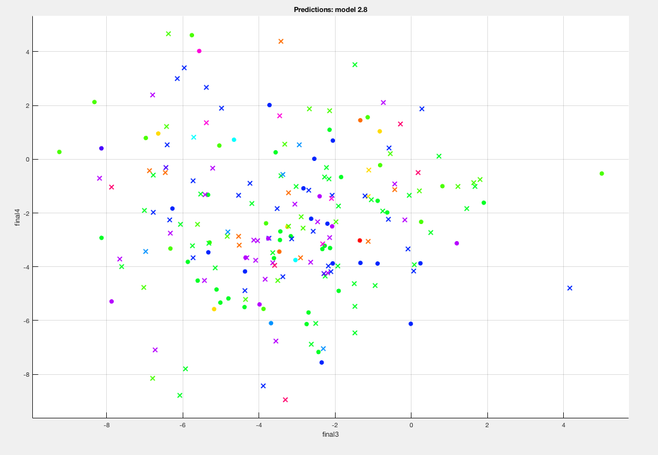
AlexNet Feature Extraction Results
Cubic Support Vector Machines performed the best during the evaluation with accuracy 35.1%.
We believe this accuracy could have been higher if more data were used for the training of the model.

Slide 21
Challenges
Some images were incompatible for AlexNet’s CNN algorithm.
Some images were too large (over 200MB) for Python to process.
Convolutional Neural Networks require a lot of data to be trained, more than we could provide

Slide 22
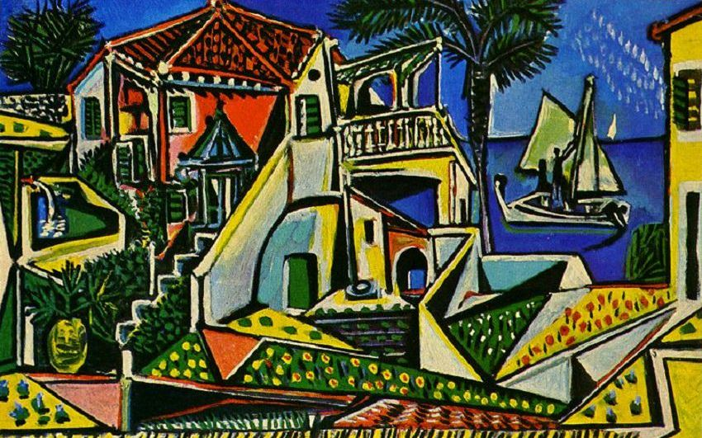
Thank you for your time

